Slide 1
Intro to Machine Learning
Lecture 2
Adil Khan
a.khan@innopolis.ru

Slide 2
Recap
What is machine learning?
Why learn/estimate?
Predictors and response variables
Types of learning
Regression and classification
Parametric and non-parametric models
Bias and variance

Slide 3
Today’s Objectives
What is linear regression?
Why study linear regression?
What can we use it for?
How to perform linear regression?
How to estimate its performance?

Slide 4
We Will Start with this Example
Advertising data:
Response (sales): in thousands of units sold
Predictors (TV, Radio, Newspaper): advertising budget in thousands of dollars
TV | Radio | Newspaper | Sales
230.1 | 37.8 | 69.2 | 22.1
44.5 | 39.2 | 45.1 | 10.4
17.2 | 45.9 | 69.3 | 9.3
151.5 | 41.3 | 58.5 | 18.5
180.8 | 10.8 | 58.4 | 12.9
8.7 | 48.9 | 75.0 | 7.2

Slide 5
What we might want to know?
Is there a relationship between advertising budget and sales?
How strong is the relationship between advertising budget and sales?
Which media contribute to sales?
How accurately can we estimate the effect of each medium on sales?
How accurately can we predict future sales?
Is there synergy among the advertising media?

Slide 6
What we might want to know?
Is there a relationship between advertising budget and sales?
How strong is the relationship between advertising budget and sales?
Which media contribute to sales?
How accurately can we estimate the effect of each medium on sales?
How accurately can we predict future sales?
Is there synergy among the advertising media?
Prediction or Inference?

Slide 7
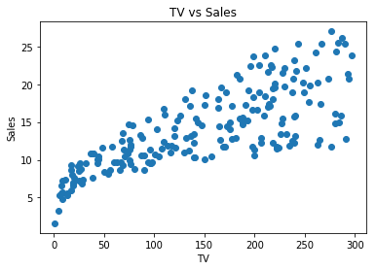
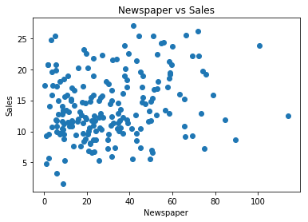
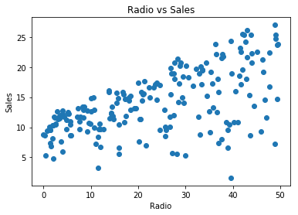
Formulate the Learning Problem
$$Sales=f\left(TV,Newspaper, Radio\right)+ε$$
$$\hat{Sales}≈\hat{f}\left(TV,Newspaper, Radio\right)$$
Notes:
The goal will be to estimate f, and then use it to estimate sales.

Slide 8
Determine the Nature of the Learning Problem
$$\hat{Sales}≈\hat{f}\left(TV,Newspaper, Radio\right)$$
Classification or Regression?
Notes:
Why simplify?

Slide 9

Simplify the Regression Problem
$$\hat{Sales}≈\hat{f}\left(TV,Newspaper, Radio\right)$$
Assume $f$ to be a function of finite parameters
Notes:
Why simplify?

Slide 10
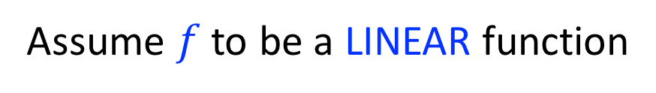
Further Simplify the Regression Problem
$$\hat{Sales}≈\hat{f}\left(TV,Newspaper, Radio\right)$$
Assume $f$ to be a LINEAR function
Notes:
Why simplify?

Slide 11
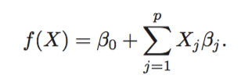
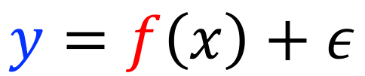
Which Brings us to Linear Regression!
Linear Regression
$$y=f\left(x\right)+ε$$
Notes:
The response variable is quantitative
The relationship between response and predictors (the function f) is assumed to be linear in the inputs
Thus we are restricting ourselves to a hypothesis space of linear functions

Slide 12
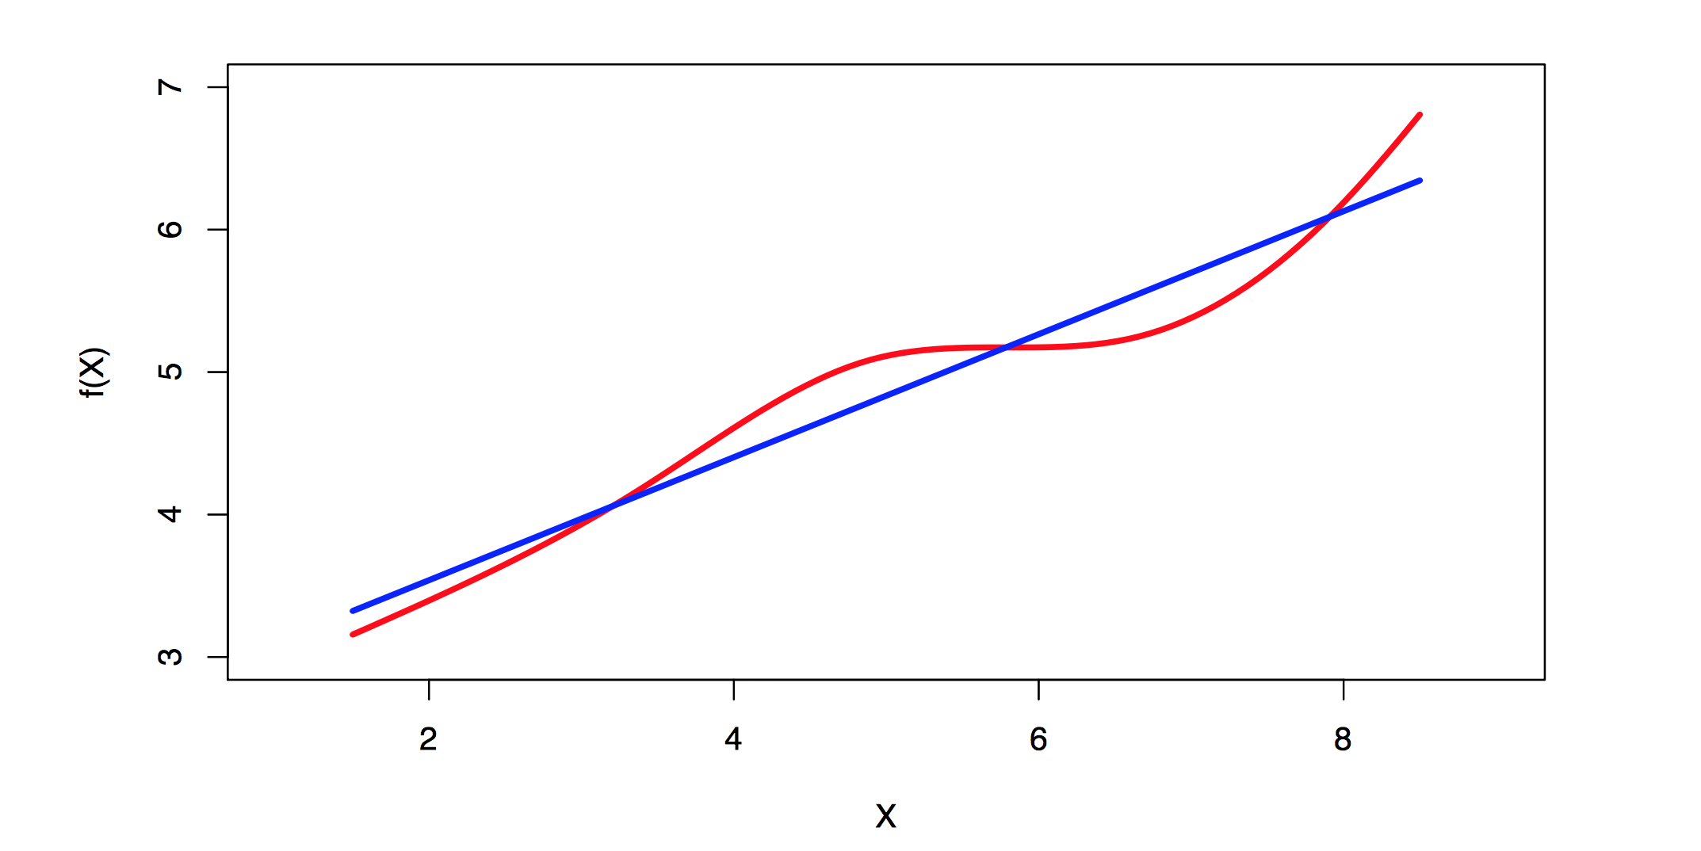
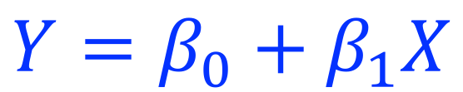
Linear Regression
A simple supervised learning approach
Assumes a linear relationship between the predictors and the response
$$Y=β_{0}+β_{1}X$$
Notes:
Linear regression is a simple approach to supervised learning.
Assumes a linear relationship between the response and the predictors.

Slide 13
Why study linear regression?
Although it may seem overly simplistic, linear regression is extremely useful both conceptually and practically.
It is still a useful and widely used statistical learning method
It serves as a good jumping-off point for newer approaches:

Slide 14
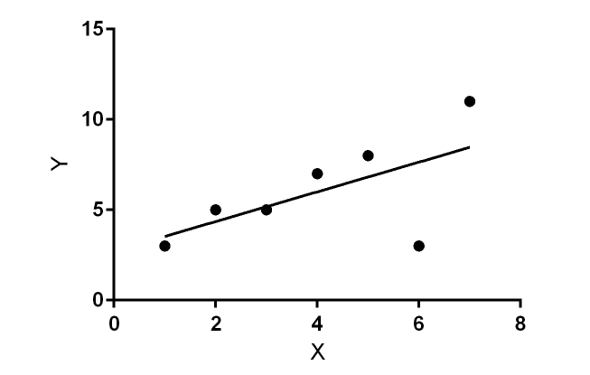
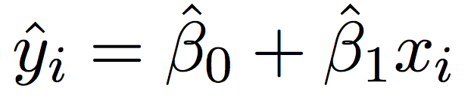
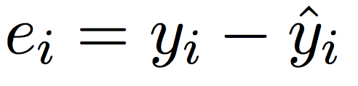
Estimating LR Parameters by Least Squares (1)

Slide 15
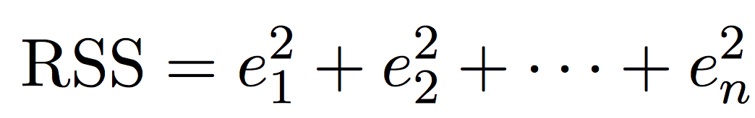
Estimating Parameters by Least Squares (2)
Residual sum of squares

Slide 16
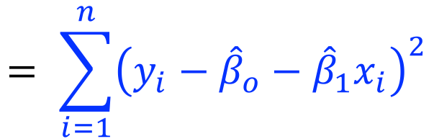
Estimating Parameters by Least Squares (3)
$$= \sum_{i=1}^{n}{{\left(y_{i}−{\hat{β}}_{o}−{\hat{β}}_{1}x_{i}\right)}^{2}}$$

Slide 17
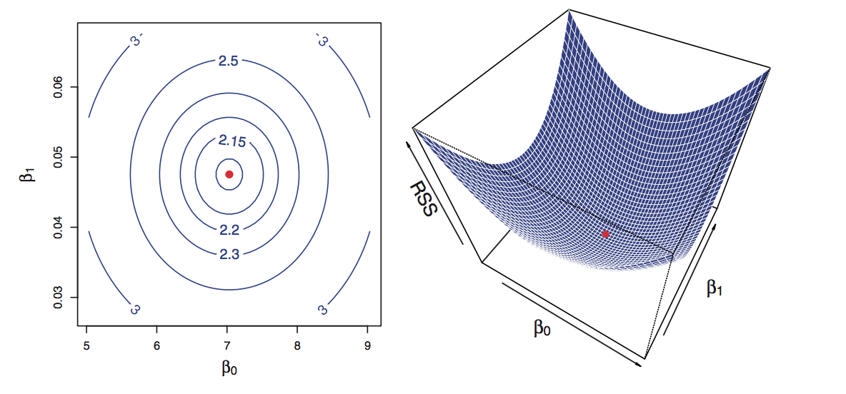
Estimating Parameters by Least Squares (4)
Contour and three-dimensional plots of the RSS

Slide 18
Estimating Parameters by Least Squares (5)
Thus, we need to find values for our parameters that minimize the risk
And, this is where the derivatives and gradients help us

Slide 19
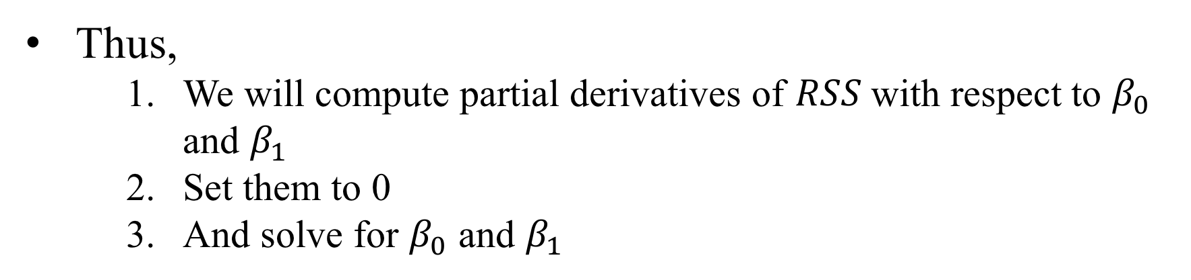
Estimating Parameters by Least Squares (5)
Thus,
We will compute partial derivatives of $RSS$with respect to $β_{0}$ and $β_{1}$
Set them to 0
And solve for $β_{0}$ and $β_{1}$

Slide 20
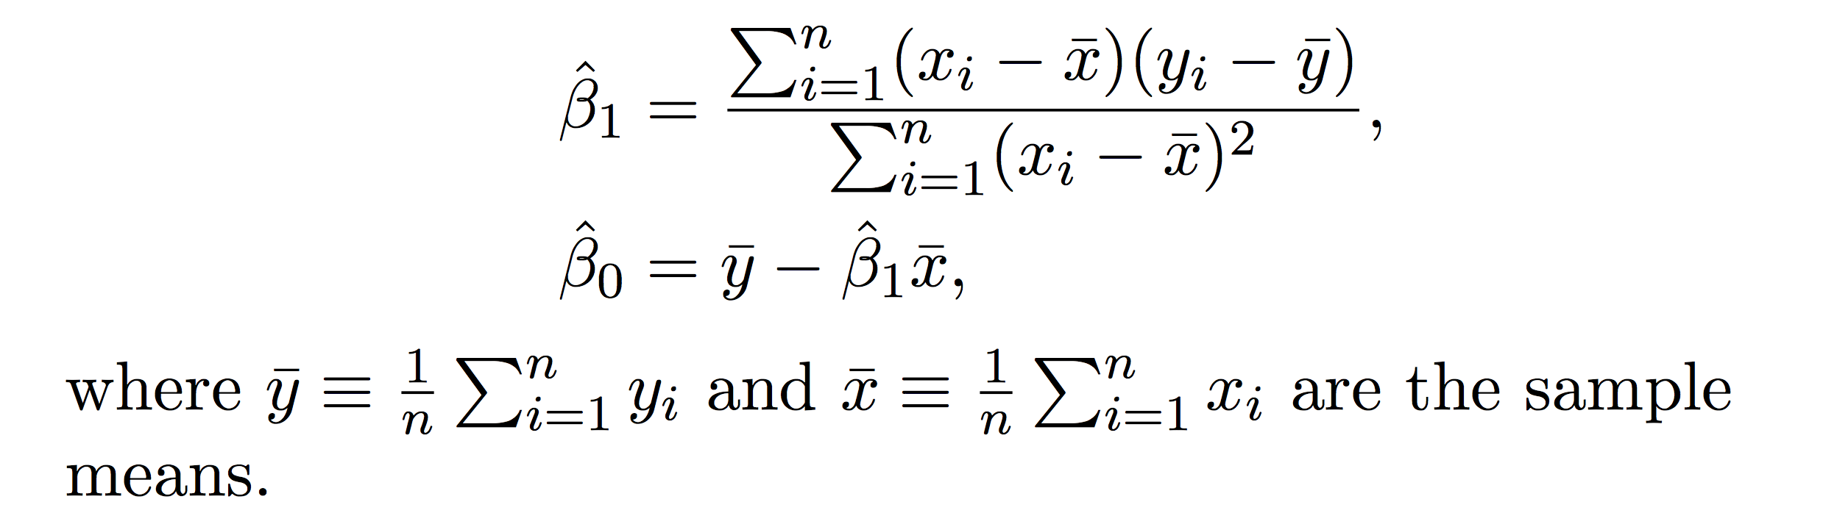
Estimating Parameters by Least Squares (6)
Doing the said calculus and algebra, the minimizing values can be found as
Notes:
The above form can be derived by finding the partial deviates of the cost function w.r.t both parameters and solving them for 0.

Slide 21
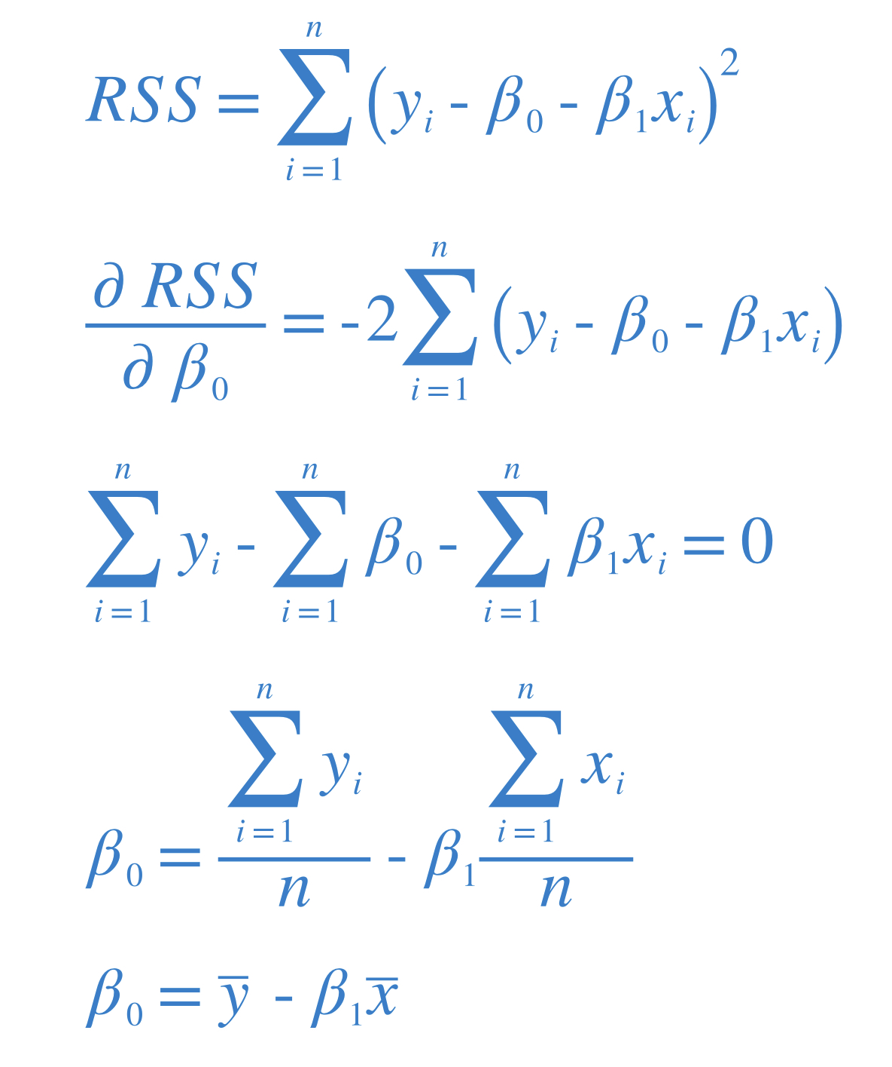
See it for the Intercept. For ease I did not use the hat symbol

Slide 22
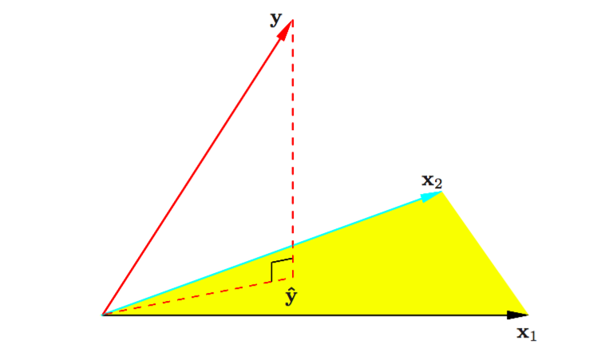

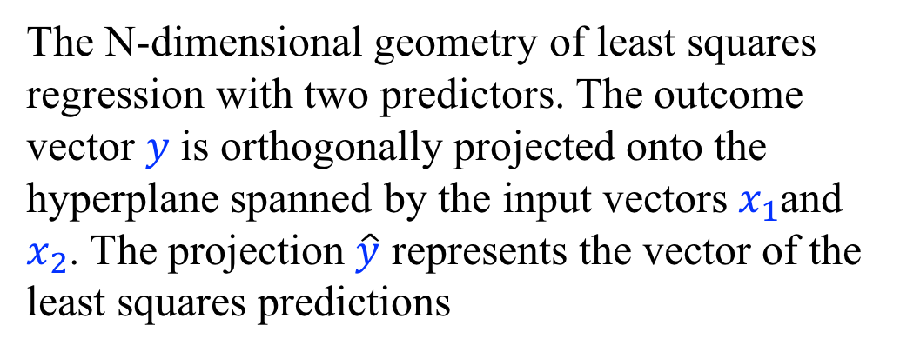
Geometry of Least Square Regression
The N-dimensional geometry of least squares regression with two predictors. The outcome vector $y$is orthogonally projected onto the hyperplane spanned by the input vectors $x_{1}$and $x_{2}$. The projection $\hat{y}$ represents the vector of the least squares predictions

Slide 23
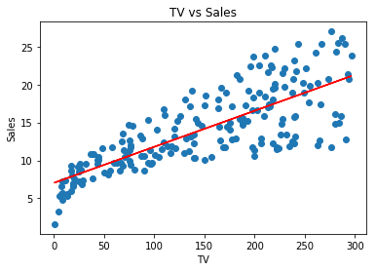

For our Sales Example
Parameters | Values
Intercept | 7.0326
TV | 0.475
$$\hat{Sales}≈{\hat{β}}_{0}+{\hat{β}}_{1}TV$$
Notes:
The values of the parameters for our problem when solved using the least squares.

Slide 24
Interpreting the Results
As per this estimation, an additional $1,000 spent on TV advertising is associated with selling approximately 47.5 additional units of the product.
Parameters | Values
Intercept | 7.0326
TV | 0.475

Slide 25

Now that we have the estimates, what is next?
Goodness of fit
Goodness of estimate
$$\hat{Sales}≈{\hat{β}}_{0}+{\hat{β}}_{1}TV$$
Parameters | Values
Intercept | 7.0326
TV | 0.475
Notes:
Notice that these are parameters of the ‘true best linear fit’.

Slide 26
Now that we have estimates, what is next?
Goodness of fit (How best does the chosen model describe the data?)
Goodness of estimate (Given the model, Is there really a relationship between response and predictor?)
$$\hat{Sales}≈{\hat{β}}_{0}+{\hat{β}}_{1}TV$$
Parameters | Values
Intercept | 7.0326
TV | 0.475
Notes:
Notice that these are parameters of the ‘true best linear fit’.

Slide 27


Goodness of Estimate (1)
Is there really a relationship between sales (response) and TV (predictor)?
Mathematically this corresponds to
verses
$$H_{0}:β_{1}=0$$
$$\hat{Sales}≈{\hat{β}}_{0}+{\hat{β}}_{1}TV$$
$$H_{a}:β_{1}≠0$$
Parameters | Values
Intercept | 7.0326
TV | 0.475
Notes:
Notice that these are parameters of the ‘true best linear fit’.

Slide 28
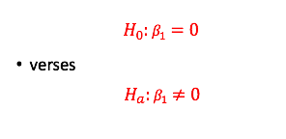
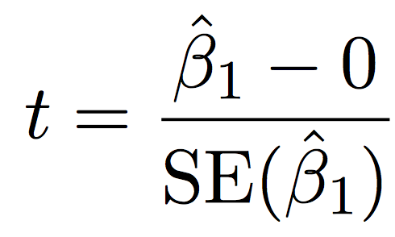
Goodness of Estimate (2)
Is there really a relationship between sales (response) and TV (predictor)?
For this, we calculate t-statistics
Where SE is an estimate of how close the estimated parameter value is to its true value
$$\hat{Sales}≈{\hat{β}}_{0}+{\hat{β}}_{1}TV$$
Parameters | Values
Intercept | 7.0326
TV | 0.475
Notes:
Thus we will have to figure out a way to answer the ‘null hypothesis’ using the estimates of the coefficients or parameters.
This can be done using t-statistics which helps us to find evidence of a significant difference between ourestimate and the hypothesized value (0 in this case).

Slide 29
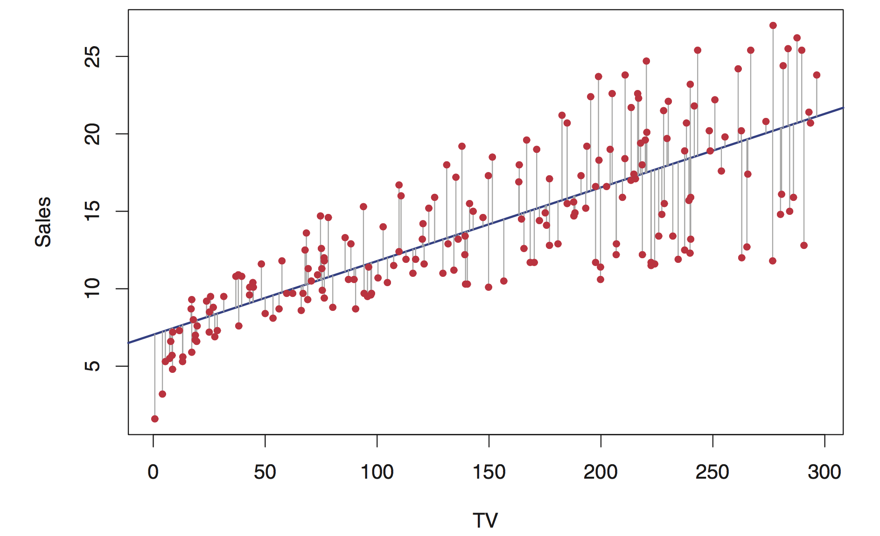
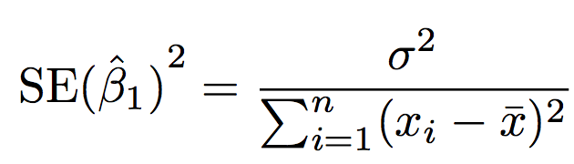
Aside: SE

Slide 30
For Our Example
t-statistics
The greater the magnitude of t, the greater the evidence against the null hypothesis
$$\hat{Sales}≈{\hat{β}}_{0}+{\hat{β}}_{1}TV$$
Parameters | Values | t-value
Intercept | 7.0326 | 15.360
TV | 0.475 | 17.668

Slide 31
For Our Example
t-statistics
The greater the magnitude of t, the greater the evidence against the null hypothesis
$$\hat{Sales}≈{\hat{β}}_{0}+{\hat{β}}_{1}TV$$
Parameters | Values | t-value
Intercept | 7.0326 | 15.360
TV | 0.475 | 17.668
Remember, we are dealing with estimates, thus we should also eliminate the risk that the resulting t-value was not by chance.

Slide 32

Chances of getting the Resulting t-value
For this, we calculate p-value
Probability of getting $|t|$ assuming $β_{1}$was 0
$$\hat{Sales}≈{\hat{β}}_{0}+{\hat{β}}_{1}TV$$
Parameters | Values | t-value | p-value
Intercept | 7.0326 | 15.360 | < 0.0001
TV | 0.475 | 17.668 | < 0.0001

Slide 33
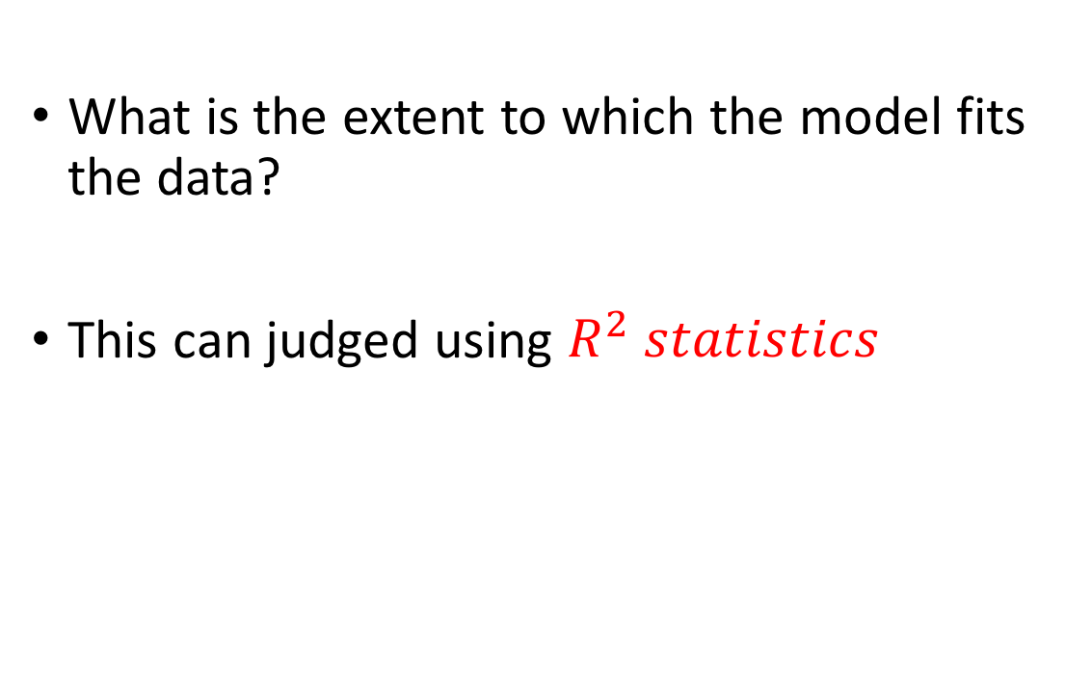
Was our Assumption about the Model Correct?
What is the extent to which the model fits the data?
This can judged using $R^{2} statistics$
$$\hat{Sales}≈{\hat{β}}_{0}+{\hat{β}}_{1}TV$$
Parameters | Values | t-value | p-value
Intercept | 7.0326 | 15.360 | < 0.0001
TV | 0.475 | 17.668 | < 0.0001

Slide 34
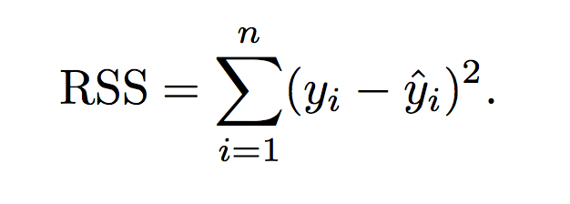

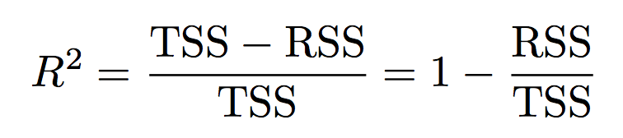
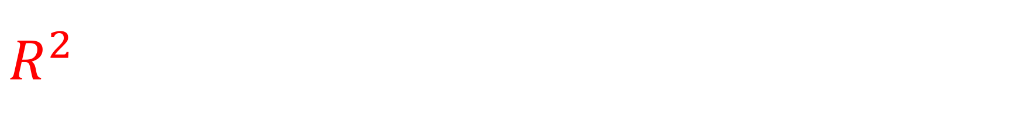
$$R^{2}$$
R-squared: how much do we gain by using the learned models instead of using the mean as the model (no independent variables)

Slide 35

For Our Example
$R^{2} statistics$
In this case, it is 0.612
$$\hat{Sales}≈{\hat{β}}_{0}+{\hat{β}}_{1}TV$$
Parameters | Values | t-value | p-value
Intercept | 7.0326 | 15.360 | < 0.0001
TV | 0.475 | 17.668 | < 0.0001
Notes:
so just under two-thirds of the variability in sales is explained by a linear regression on TV .
In this case, the value of 0.612 means that using the TV budget we reduced the variance in sales by 61%.

Slide 36
Multiple Linear Regression (1)
Simple linear regression is a useful approach for predicting a response on the basis of a single predictor variable.
However, in practice we often have more than one predictor
Sales (TV, Radio, Newspaper)
Income (Years of education, Years of experience, Age, Gender)

Slide 37
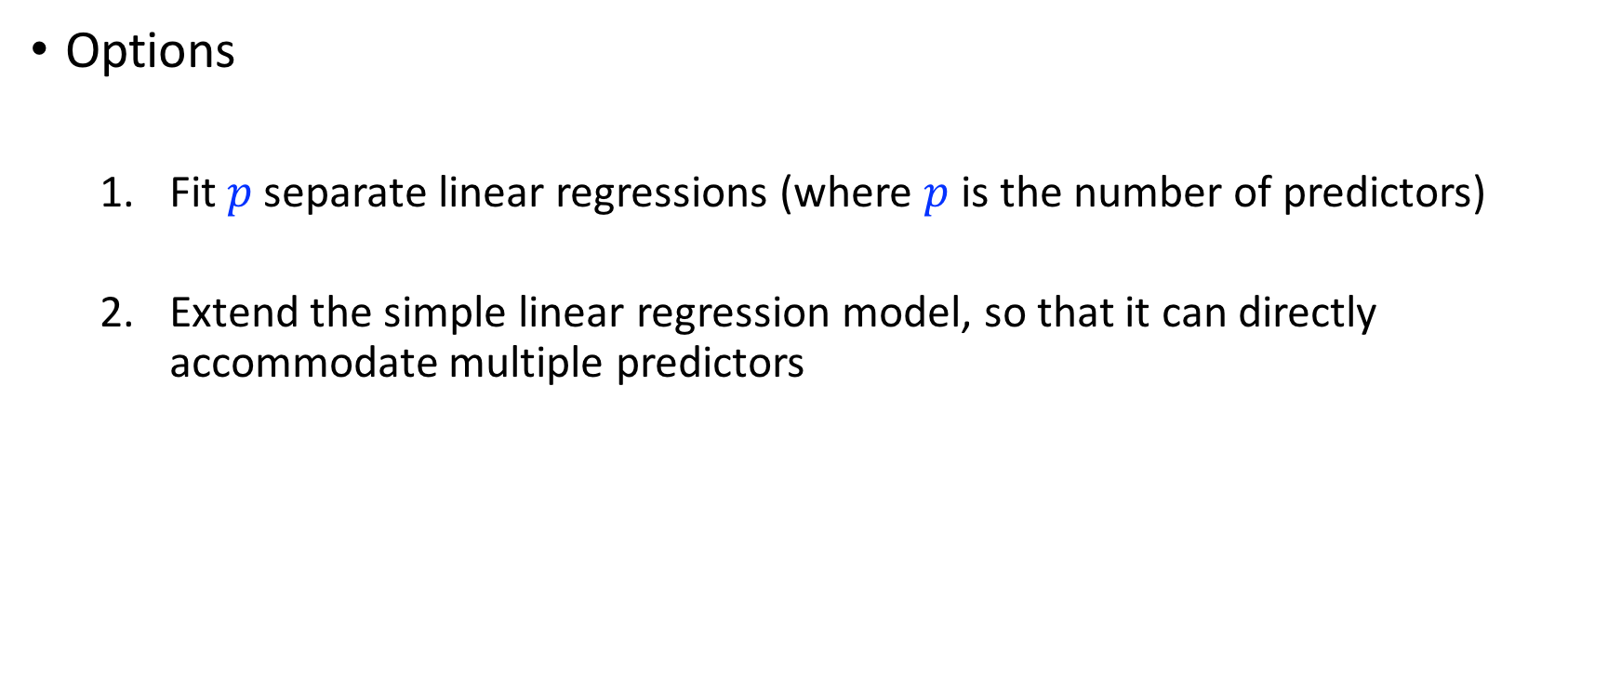
Multiple Linear Regression (2)
Options
Fit $p$ separate linear regressions (where $p$ is the number of predictors)
Extend the simple linear regression model, so that it can directly accommodate multiple predictors
Notes:
However, the approach of fitting a separate simple linear regression model for each predictor is not entirely satisfactory. First of all, it is unclear how to make a single prediction of sales given levels of the three advertising media budgets, since each of the budgets is associated with a separate regression equation. Second, each of the three regression equations ignores the other two media in forming estimates for the regression coefficients.

Slide 38

Multiple Linear Regression (3)
Options
Fit $p$ separate linear regressions (where $p$ is the number of predictors)
Extend the simple linear regression model, so that it can directly accommodate multiple predictors

Slide 39
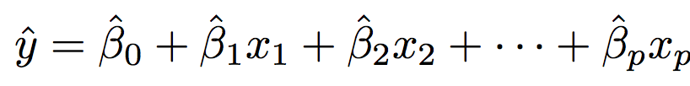

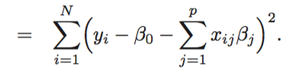
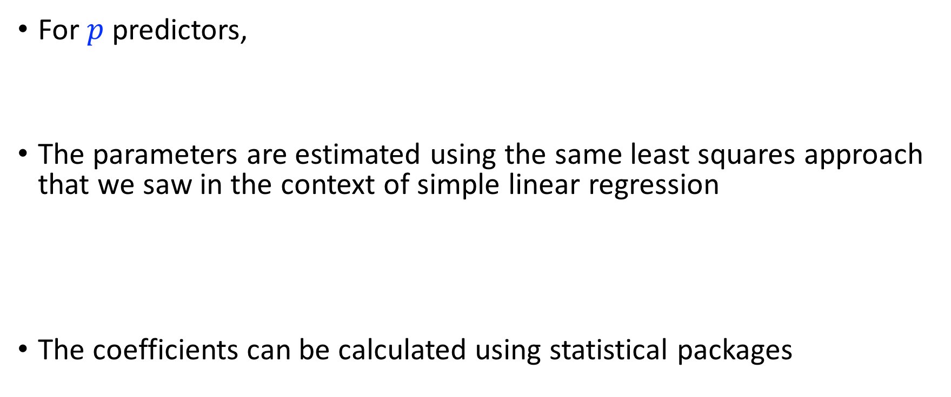
Multiple Linear Regression (4)
For $p$ predictors,
The parameters are estimated using the same least squares approach that we saw in the context of simple linear regression
The coefficients can be calculated using statistical packages

Slide 40
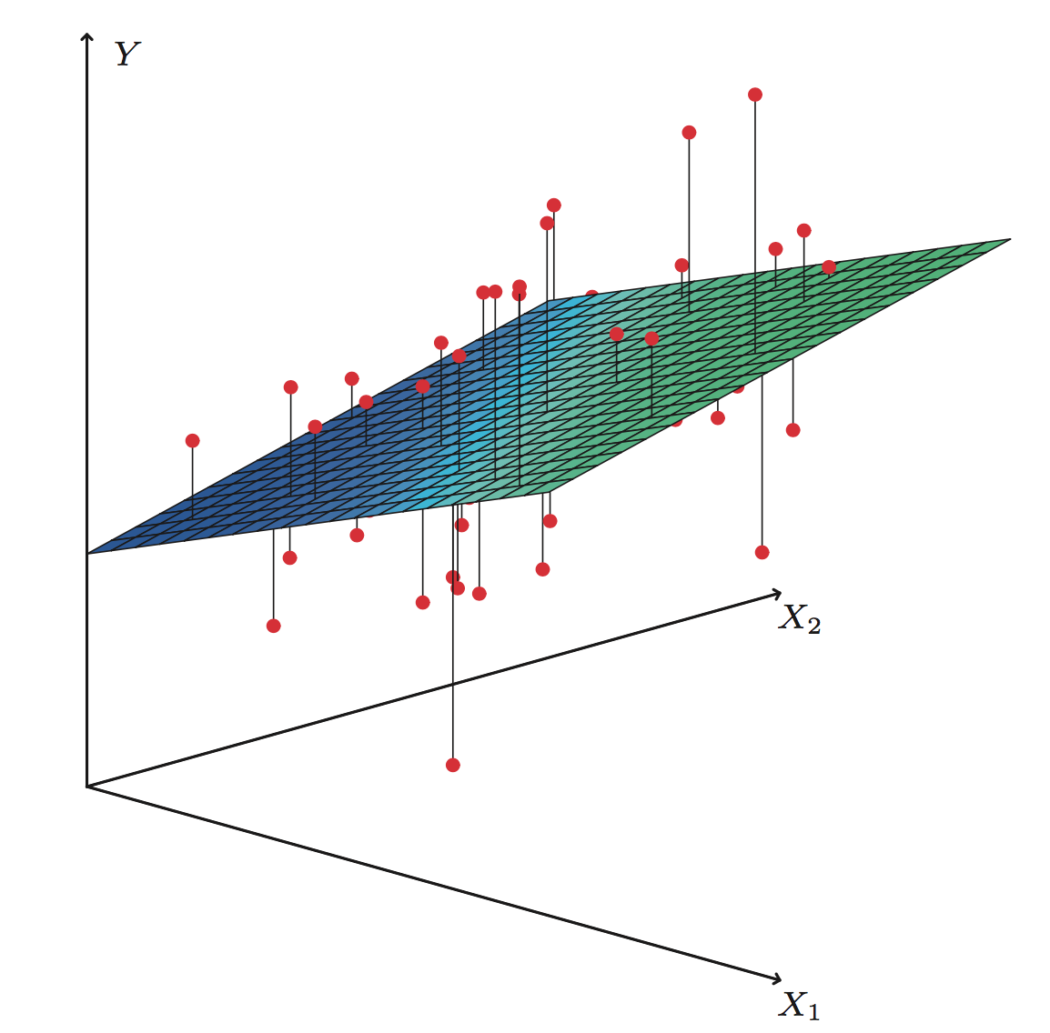
Multiple Linear Regression (5)
For two predictors, the regression might look as follows
Notes:
In a three-dimensional setting, with two predictors and one response, the least squares regression line becomes a plane. The plane is chosen to minimize the sum of the squared vertical distances between each observation (shown in red) and the plane

Slide 41
For Our Sales Example
Parameters | Values | t-value | p-value
Intercept | 2.939 | 9.42 | < 0.0001
TV | 0.46 | 32.81 | < 0.0001
Radio | 0.189 | 21.89 | < 0.0001
Newspaper | -0.001 | -0.18 | < 0.8599
For the Advertising data, least squares coefficient estimates of the multiple linear regression of number of units sold on radio, TV, and newspaper advertising budgets.

Slide 42
Multiple Linear Regression (7)
Parameters | Values | t-value | p-value
Intercept | 2.939 | 9.42 | < 0.0001
TV | 0.46 | 32.81 | < 0.0001
Radio | 0.189 | 21.89 | < 0.0001
Newspaper | -0.001 | -0.18 | < 0.8599
Compare the results for ‘Newspaper’ of multiple regression (above) to that of linear regression (above)
Parameters | Values | t-value | p-value
Intercept | 12.351 | 19.88 | < 0.0001
Newspaper | 0.055 | 3.30 | 0.00115
Notes:
Does it make sense for the multiple regression to suggest no relationship between sales and newspaper while the simple linear regression implies the opposite?

Slide 43
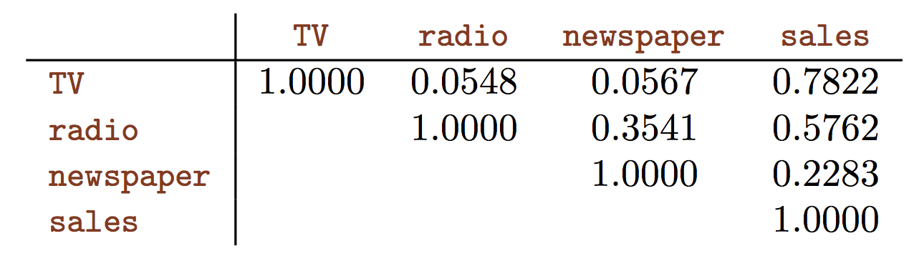
Multiple Linear Regression (7)
Parameters | Values | t-value | p-value
Intercept | 2.939 | 9.42 | < 0.0001
TV | 0.46 | 32.81 | < 0.0001
Radio | 0.189 | 21.89 | < 0.0001
Newspaper | -0.001 | -0.18 | < 0.8599
Correlation matrix for TV, radio, newspaper, and sales for the Advertising data
Notes:
Notice that the correlation between radio and newspaper is 0.35. This reveals a tendency to spend more on newspaper advertising in markets where more is spent on radio advertising.
Hence, in a simple linear regression which only examines sales versus newspaper, we will observe that higher values of newspaper tend to be associated with higher values of sales, even though newspaper advertising does not actually affect sales. So newspaper sales are a surrogate for radio advertising; newspaper gets “credit” for the effect of radio on sales.

Slide 44
Interpreting the Results of MLR (1)
1. Is there any predictor which is useful in predicting the response?
We might think that (just like LR) we can use p-value for this, but we are wrong
Parameters | Values | t-value | p-value
Intercept | 2.939 | 9.42 | < 0.0001
TV | 0.46 | 32.81 | < 0.0001
Radio | 0.189 | 21.89 | < 0.0001
Newspaper | -0.001 | -0.18 | < 0.8599
Notes:
This logic is flawed, especially when the number of predictors p is large.
For instance, consider an example in which p = 100 and H0 : β1 = β2 = . . . = βp = 0 is true, so no variable is truly associated with the response.
In this situation, about 5 % of the p-values associated with each variable will be below 0.05 by chance.
In other words, we expect to see approximately five small p-values even in the absence of any true association between the predictors and the response. Thus we will incorrectly conclude that there is a relationship.

Slide 45
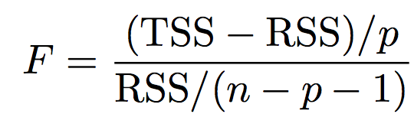
Interpreting the Results of MLR (2)
1. Is there any predictor which is useful in predicting the response?
Thus we use another measure called F-statistics
These two quantities are expected to be the same under Null Hypothesis

Slide 46
Interpreting the Results of MLR (3)
1. Is there any predictor which is useful in predicting the response?
Thus we use another measure called F-statistics
Parameters | Values | t-value | p-value
Intercept | 2.939 | 9.42 | < 0.0001
TV | 0.46 | 32.81 | < 0.0001
Radio | 0.189 | 21.89 | < 0.0001
Newspaper | -0.001 | -0.18 | < 0.8599
F-statistics | 570
Since this is far larger than 1, it provides compelling evidence against the null hypothesis H0.
In other words, the large F-statistic suggests that at least one of the advertising media must be related to sales

Slide 47
Interpreting the Results of MLR (4)
1. Is there any predictor which is useful in predicting the response?
But how far away from 0 F-statistics has to be?
Notes:
It turns out that the answer depends on the values of n and p.
When n is large, an F-statistic that is just a little larger than 1 might still provide evidence against H0. In contrast, a larger F-statistic is needed to reject H0 if n is small.
For any given value of n and p, any statistical software package can be used to compute the p-value associated with the F-statistic. Based on this p-value, we can determine whether or not to reject H0.

Slide 48
Interpreting the Results of MLR (5)
2. Do all the predictors help explain the response or is only a subset of them useful?
Forward selection
Backward selection
Mixed selection
Notes:
Forward selection. We begin with the null model—a model that contains an intercept but no predictors. We then fit p simple linear regressions and add to the null model the variable that results in the lowest RSS. We then add to that model the variable that results in the lowest RSS for the new two-variable model. This approach is continued until some stopping rule is satisfied.
Backward selection. We start with all variables in the model, and remove the variable with the largest p-value—that is, the variable that is the least statistically significant. The new (p − 1)-variable model is fit, and the variable with the largest p-value is removed. This procedure continues until a stopping rule is reached. For instance, we may stop when all remaining variables have a p-value below some threshold.
Mixed selection. This is a combination of forward and backward se- lection.

Slide 49
Do all the predictors help explain the response or is only a subset of them useful?
Forward Selection
We begin with the null model—a model that contains an intercept but no predictors.
We then fit p simple linear regressions and add to the null model the variable that results in the lowest RSS.
We then add to that model the variable that results in the lowest RSS for the new two-variable model. This approach is continued until some stopping rule is satisfied.
Notes:
Forward selection. We begin with the null model—a model that contains an intercept but no predictors. We then fit p simple linear regressions and add to the null model the variable that results in the lowest RSS. We then add to that model the variable that results in the lowest RSS for the new two-variable model. This approach is continued until some stopping rule is satisfied.
Backward selection. We start with all variables in the model, and remove the variable with the largest p-value—that is, the variable that is the least statistically significant. The new (p − 1)-variable model is fit, and the variable with the largest p-value is removed. This procedure continues until a stopping rule is reached. For instance, we may stop when all remaining variables have a p-value below some threshold.
Mixed selection. This is a combination of forward and backward se- lection.

Slide 50
Do all the predictors help explain the response or is only a subset of them useful?
Backward Selection
We start with all variables in the model, and remove the variable with the largest p-value—that is, the variable that is the least statistically significant.
The new (p − 1)-variable model is fit, and the variable with the largest p-value is removed.
This procedure continues until a stopping rule is reached. For instance, we may stop when all remaining variables have a p-value below some threshold.
Notes:
Forward selection. We begin with the null model—a model that contains an intercept but no predictors. We then fit p simple linear regressions and add to the null model the variable that results in the lowest RSS. We then add to that model the variable that results in the lowest RSS for the new two-variable model. This approach is continued until some stopping rule is satisfied.
Backward selection. We start with all variables in the model, and remove the variable with the largest p-value—that is, the variable that is the least statistically significant. The new (p − 1)-variable model is fit, and the variable with the largest p-value is removed. This procedure continues until a stopping rule is reached. For instance, we may stop when all remaining variables have a p-value below some threshold.
Mixed selection. This is a combination of forward and backward se- lection.

Slide 51
Do all the predictors help explain the response or is only a subset of them useful?
Mixed Selection
Left as home reading
Notes:
Forward selection. We begin with the null model—a model that contains an intercept but no predictors. We then fit p simple linear regressions and add to the null model the variable that results in the lowest RSS. We then add to that model the variable that results in the lowest RSS for the new two-variable model. This approach is continued until some stopping rule is satisfied.
Backward selection. We start with all variables in the model, and remove the variable with the largest p-value—that is, the variable that is the least statistically significant. The new (p − 1)-variable model is fit, and the variable with the largest p-value is removed. This procedure continues until a stopping rule is reached. For instance, we may stop when all remaining variables have a p-value below some threshold.
Mixed selection. This is a combination of forward and backward se- lection.

Slide 52
Interpreting the Results of MLR (6)
3. How well does the model fit the data?
Same as LR with single parameter (R-squared)

Slide 53

Potential Problems with Linear Regression
Non-linearity of $f$
Correlation of error terms
Non-constant variance of error terms
Outliers
High-leverage points
Collinearity

Slide 54
Did we achieve today’s objectives objectives?
What is linear regression?
Why study linear regression?
What can we use it for?
How to perform linear regression?
How to estimate its performance?

